Slide 1
Some Strategies for Small Town Downtown Revitalization
N. David Milder
718-805-9507
www.ndavidmilder.com
dmilder@gmail.com
Presented to
The 7 Rivers Alliance’s Revitalize Storefronts Conference
Cashton WI
November 19, 2015
© N. David Milder. All Rights Reserved
Notes:
© N. David Milder. November 2015. All rights reserved.

Slide 2
Strategies to be discussed:
Developing and strengthening your downtown’s Central Social District (CSD) functions, especially the entertainment niche
Attracting new residents who either do not need jobs, will bring their jobs with them or can create their own good jobs.

Slide 3
In the New Normal for Downtowns…
CENTRAL SOCIAL DISTRICT (CSD) FUNCTIONS
ARE OFTEN BECOMING MORE IMPORTANT
THAN CBD FUNCTIONS, e.g., retail and offices

Slide 4
Your CSD is…
The downtown area with activity venues that facilitate people having enjoyable experiences with other people, usually relatives and friends, but, importantly, sometimes strangers.

Slide 5
Some CSD Components: (EN = entertainment niche)
Movie theaters (EN)
PACs (EN)
Concert Halls(EN)
Museums (EN)
Art galleries (EN)
Arenas (EN)
Stadiums (EN)
Senior centers, community centers (EN)
Pamper niche venues (gyms, nail & hair salons)
Restaurants and drinking places (EN)
Parks/public spaces (EN)
Ice cream parlors; pizza, hot dog, sausage joints (EN)
Places of worship
Social clubs, (EN)
Catering halls (EN)
Public markets (EN)
Schools

Slide 6
An entertainment niche is a subset of the CSD. Three of its components should be given top priority:
Restaurants and drinking places
Parks and Public Spaces
Movie Theaters

Slide 7
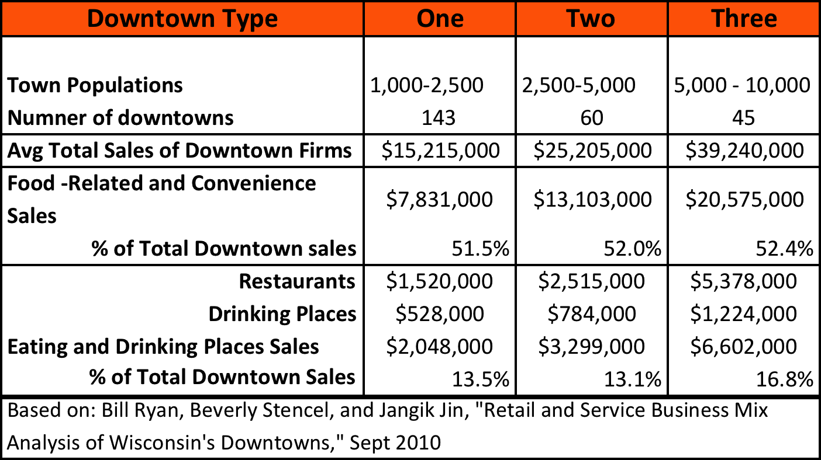
Restaurants and drinking places are vital social amenities and they can make it in small WI towns

Slide 8
Here’s why…

Slide 9
Here’s why 2…
Relatively low market share needs to be won to be viable
Relatively low rent and labor costs
They now account for about 13% of the annual sales in WI small downtowns – more viable than most GAFO retail
We are now spending more on eating out than on eating at home

Slide 10
Biggest restaurant challenges in small towns…
Small market area → low revenue potentials
Low revenue potentials → quality restaurant operators and chefs probably will NOT be attracted from the outside
High quality needed to draw customers from a larger market area
Nationally, strong growth → skilled kitchen staff now harder to find
HOW CAN QUALITY BE IMPROVED?

Slide 11
Parks and public spaces are often far better strategic choices than formal entertainment venues* because they …
Are usually much cheaper to build
Are much cheaper to operate and maintain
Draw many more visitors
Have far fewer user frictions
*PACs, theaters, museums, arenas, stadiums, convention centers

Slide 12
Some relevant data…

Slide 13
Mitchell Park in Greenport, NY – year round population 2,200
Has a strong flow of tourists in season (many shops close in winter)
The park has an antique carrousel, marina and winter skating rink on a waterfront location
Cost about $14.9 million to build
Costs about $1 million/yr to operate. Most of the costs are covered by user fees
Reportedly gets about 390,000 visitors/yr

Slide 14
Division Street Plaza in Somerville, NJ – population 12,100
Basically a 1-block long successful pedestrian mall. Unusual because about 90% of them have failed
Cost about $675,000 to create
Costs about $62,500/yr to operate
Annually businesses are attracting 116,000 to 128,000 patrons and events are attracting about 100,00 visitors

Slide 15
Grand Central Plaza in Valparaiso, IN – population 32,000
Park with amphitheater, ice rink and catering facility
Cost about $3.25 million to build Phase 1; $4 million for new addition
2014 operating costs about $460,000/yr; $100,000 by city; $360,000 by Valparaiso Events
Had about 130,000 visitors in 2014

Slide 16
The types of organizations that made these projects happen…
Greenport’s Mitchell Park: the Village government
Somerville’s Division Street Plaza: the Town government, but mostly the BID
Valparaiso’s Grand Central Plaza: City government and downtown biz group nonprofit
Local government action is essential – those that provide for-a-fee business-like services are more likely to succeed.

Slide 17
How are they financed? In many ways…
Greenport’s Mitchell Park: operations covered mostly by user fees. Village spent about $4 million on its development, rest came from 25+ grants and donations.
Somerville’s Division Street Plaza: the Town government handles physical maintenance, the BID covers events, marketing, sanitation. Initial construction covered by Federal transportation program funds
Valparaiso’s Grand Central Plaza: City government handles physical maintenance; sold naming rights covers most of it. Downtown biz group applies user fees and sponsorship funds to pay for events and marketing. Private donations and TIF funds covered $4 million expansion. TIF funds and state and Federal grants covered most of Phase 1’s construction costs.

Slide 18
Downtown movie theaters are treasures, but under constant threat
They draw about 50,000 patrons/yr/screen
They are affordable
They are open days/evenings/weekends
They have relatively few user frictions
But, they provide a small part of movie studio revenues
The marketing platform they provide is what is keeping the studios connected
Most movies are watched at home – cinema attendance down.
A closed cinema is a terrible loss!

Slide 19
The challenge is to keep the cinemas you have open, vibrant and profitable
New small town cinemas impossible to get!
Recently, in crossing the “digital divide,” many communities devised viable strategies for saving their theaters:
Crowdfunding
Community owned businesses
Creating opportunities for patrons to make a “night a night of it” by tie-ins with nearby eateries and improved public spaces
A viable rescue plan should be ready to go.

Slide 20
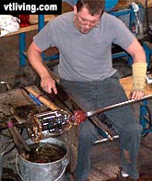
THE JOBS PROBLEM (Not Steve)
Focus More on Attracting and Supporting People, Less on Big Firms With Putative Jobs

Slide 21
Meta Strategy for Overcoming Small Town Sparsely Populated and Resourced Market Areas: Tap Denser & Richer Distant Areas
Tourism
Using the Internet
For More Customers
For Better Employment Opportunities
For Education and Health Services
Attracting New Residents From Urban and Suburban Areas

Slide 22
The Pivotal Economic Challenge
In our review of the literature, access to good jobs was seen as the pivotal economic problem of small and rural communities
Without good jobs, people will neither want to stay in or move to these communities
The favorite strategic response seemed to be, based on a cluster analysis, to try to recruit outside firms that can bring in lots of jobs
This strategy, too often, has high costs, a low ROI and will fail too many small towns.

Slide 23
While most American adults do not want to live in a rural area, a very significant percentage do!

Slide 24
Extrapolating from the Trulia survey data…
About 61 million American adults prefer living in rural areas
That’s greater than the entire population of the UK or Italy
About 15.5 million American adults would like to live in a rural area, but now don’t
That’s greater than the entire population of Greece, Hungary or Sweden.

Slide 25
Don’t count any age group out
The preference for living in the suburbs and countryside over urban areas is strongest among Baby Boomers (seniors) and Gen Xers. They also have the most money!!!
But, even most Millennials now want to live in burbs and small towns. Also, 26% see themselves as rural or small town folks
Many urban Millennials can be expected to move as the marry and have children – and as rural and small town opportunities increase.
“Although there continues to be an outflow of young people up to 34 years old, rural Wisconsin experienced an increase of people 35-54 yrs old.”

Slide 26
My attempt at a quick rural small town residential locational assets and liabilities assessment
Probable Assets
Probable Liabilities
Lower housing costs
Neighborhood safety
Parks and recreation opportunities
Proximity to workplace
Proximity to good jobs
Health care services
Quality of housing stock
Proximity to shopping and entertainment
Education opportunities
It depends…
Lower cost of living
Community character, ambience, attractiveness
Walkability
Broadband

Slide 27
To penetrate this pro rural- small town market segment, a town needs…
Job opportunities – But, now in rural Wisconsin, job opportunities are about 10% less than elsewhere; wages are more than 25% less. (Rural Wisconsin Today 2013)
Attractive, affordable housing “Over one-quarter of all housing units in rural Wisconsin were built since 1990, a slightly higher percentage than Wisconsin as a whole and the United States.” (RWT 2014)
Good quality of life amenities (schools, viable Main Streets, attractive parks and public spaces, scenic views, low crime, etc.)
Adequate health care services
An adequate broadband pipe (critical for job creation, health care, education, entertainment).

Slide 28
Health care services are especially important for seniors
SCRMC Clinic in Frederic WI

Slide 29
Some Data on Housing Cost Advantages
According to a recent Urban Land article Millennial owners paid on average for new homes:
In newer suburbs: $356,604
In city downtowns: $337,232
The lowest average was $146,947 in rural areas.

Slide 30
One solution: Attract residents who do not need jobs, e.g.,…
Seniors with ample retirement incomes
The 50+ age segment is 100 million strong, growing. They control 70% of the nation’s disposable income.
Gering NE is attracting retired ranchers and farmers. Many of its tourists are good residential prospects
Seymour NE has attracted retired former residents
Meredith NH is seeing second home owners turn into full-time residents as they retire
Adequate healthcare services are critical
Second home owners
Feasible if big metro area is within a 2.5 to 3.0 hr drive; creatives big potential market segment

Slide 31
Senior Living in Gering NE

Slide 32
Another solution: Attract new residents who will bring their jobs with them
Many denizens of Kotkin’s “Valhallas” (Aspen, Jackson Hole)
Those in Central VT working in website design and services; graphics services; managing investment funds; business consulting with bosses/clients in other parts of the nation
Those with businesses and jobs that are “location free” and rely heavily on electronic communications. For example:
A leather specialist who repairs well known handbags (e.g., Coach, Longchamps, Kate Spade, etc.) for web customers; another web-based repairer focuses on Birkenstocks
A web retailer of reenactors clothing
Andrew Dane and I work on projects and co-author articles though we live about 1,000 miles apart; my webmaster is 250 miles away; I have clients in CA, OR, AZ, NH, VT, WI
Needed: decent Internet pipe, UPS/Fedex, good highway.

Slide 33
James Townsend & Son in Pierceton, IN – 33 miles from Ft Wayne

Slide 34
Solution 3: Attract people who will create their own jobs
Rebooting Seniors – many seniors want new careers to keep busy & augment income
Freelancers/Contingent Workers – always recreating their jobs
Creatives looking for a slower pace and more rustic environment (many are freelancers)
Some will do hobby related work in arts, crafts, etc.
Some will open restaurants, bars, hotels, retail shops
Some will seek new telecommuting based work assignments

Slide 35
Four “creatives’ from Brooklyn developed The Graham & Co. motel in Upstate NY

Slide 36
Why contingent/freelance workers and the self-employed are critical
They are steadily growing in number nationally, One GAO estimate (using a broad definition consistent with the title of this slide) puts it at 40% of the workforce in 2010.
In WI: “(F)rom 2000 to 2010, rural wage and salary jobs decreased by over 22,000 (-2.6%). Conversely, there was a significant jump in self-employment jobs, well over 45,000 (+ 18.7%)….” (RWT 2013)
Can the “economic gardening” of the contingents/freelancers/self-employed have more impact than a cluster based business recruitment effort?

Slide 37
Better Use of the Internet
Early hopes that the Internet would make more businesses “location free” -- and better able to thrive in rural locations by tapping urban markets and jobs – are far from being fully realized
Many areas had no or poor broadband access
Too many small business people have not known how to effectively use the Internet – changing as youths age
Powerful web-based job training, telepharmacy, telemedicine, freelancer job marts (e.g., Freelancer, Elance, Upwork, Flexjobs), fundraising programs were either not developed or not quickly enough
This is changing, but the pace of change must increase.

Slide 38
Is there a rural “creatives/knowledge workers” problem?
There is a lot of malarkey about the value of young creative hipsters and urban preferences of all creatives
Most creatives in NJ, for example, are “mature” and live in the suburbs, not urban cities.
“The percentage of rural Wisconsin residents age 25 years and older with at least a bachelors’ degree has almost tripled from 6.7 percent in 1970 to 18.7 percent today.” (RWT 2014)
Rural towns with the needed assets can and do attract creatives! For decades, we’ve seen many creatives in numerous rural places in NY, NH, VT, MA
Beautiful scenery and attractive Main Streets/CSDs help
If they visit, they’re more likely to become residents.

Slide 39
Addendum
The financial tool box available for small town downtown revitalization has loads of tools proven in small communities. See our article:
Milder, N. David, and Andrew Dane. “Some More Thoughts on the Economic Revitalization of Small Town Downtowns: Financial Tools.” Economic Development Journal of Canada, November 2014. http://tinyurl.com/qcbnefh

