Slide 1
2018 Executive Survey Results
Maddy Larrabee

Slide 2
Outline
53 responses collected online July - August of 2018
Full results will be published on our website homepage
The link is provided in the program, on Facebook, and LinkedIN

Slide 3
Business Climate
75.5%
Selected Excellent or Above Average
22.6 %
Selected Average
Which of the following best describes the 7 Rivers Region as a place to do business?
1.9 %
Selected Below Average

Slide 4
Business Climate
Better
43.4%
No Change
49.1%
In the last year, did the 7 Rivers region become a better place to do business, a worse place to do business, or has no change occurred?
Worse
7.5%

Slide 5
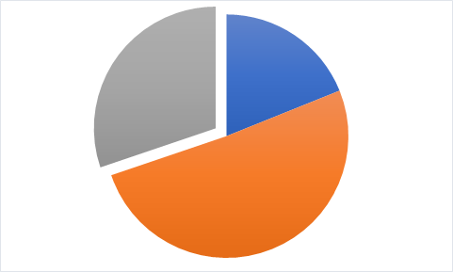
Business Climate
Excellent
18.9%
Average
30.2%
Above Average
50.9%
How would you rate the Economic Strength of the 7 Rivers Region?

Slide 6
Business Conditions
YES
66%
NO
Has your company had trouble finding qualified workers in the past year?
34%

Slide 7
Business Conditions
Out of 10 factors, top four:
Workforce Availability
Personal Costs (Wage/salary)
New Technology
Government Regulation
In the list below, please rank each factor based on its expected impact on your business over the next three years.

Slide 8
Business Conditions
YES | 13.2%
NO | 34%
MAYBE | 52.8%
Would you be willing to subsidize employee childcare if it would guarantee availability?

Slide 9
Business Conditions
If yes, what type of programs do you offer? (11 responses)
Flex Spending
Lower Child care Rates on campus
Flexible Hours
Does your company offer programs to help offset the cost of child care?
YES 20.8%
NO 79.2%

Slide 10
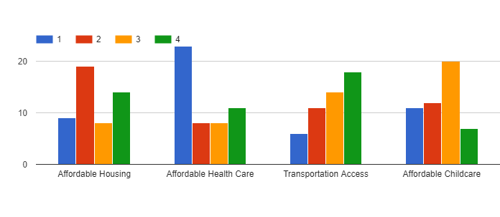
Employee Conditions
Please rank these challenges, in order of severity, faced by your employees.
Affordable Health Care
Affordable Housing

Slide 11
Employee Conditions
Too much development is occurring | 0%
There is an appropriate amount of housing | 42.9%
Too little development is occurring | 57.1%
What is your opinion of housing development in the 7 Rivers Region?

Slide 12
Trade
If no, what is permitting your company from expanding into foreign markets?
Is your company currently involved in international trade?
Business designed to serve a specific area
Lack of Export Knowledge
High Cost/Tough Competition
Yes
13.2%
NO
86.8%

Slide 13
Challenges
Out of 42 responses:
26% mentioned
Workforce Shortage
21% mentioned
Government Regulation
Other answers included changing markets, technology, and high costs
(Open Responses)
What is your firm’s biggest challenge or obstacle right now?

Slide 14
Industry Trends
(Open Response)
Out of 41 responses, 3 main categories included:
Technology usage
Government policy
Aging workforce
What trend in your industry is most likely to impact the future of business?

Slide 15
Promotion Tactics
(Open Responses)
Majority of respondents said
INTERNET
(Social Media)
Personal Sales/Word of Mouth
What tactics does your firm employ to promote business and expand into new markets?

Slide 16
Specific Sectors
Low responses
Manufacturing, Retail

Slide 17
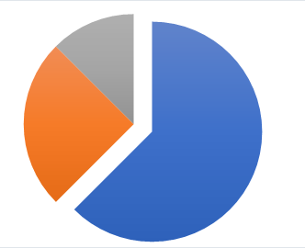
Manufacturing
What do you believe is the biggest concern facing your firm?
Supply Chain Distribution
12.5%
Geopolitical Uncertainty
25%
Worker Shortage
62.5%

Slide 18
Retail
What strategies are you using to identify new markets?
Online Tools
Word of Mouth, Trade Associations, Professional Network
What is the most important to increasing revenue?
Customer Experience
Making the next sale, employee training, increasing brand loyalty, marketing, new products

Slide 19
What’s next?
Main Takeaways
Workforce Shortage
Affordable Employee conditions including housing, health insurance, childcare.
Internet Usage
Next year
Better distribution with more collection time
More scientific

Slide 20
Questions?
Email us at info@7riversalliance.org
Visit our website at www.7RiversAlliance.org

