Slide 1
The covid state
of the Wisconsin and Minnesota economies
May 29, 2020
Ron Wirtz
Regional Outreach Director

Slide 2
First, a thank you
Speed of pandemic has made real-time information critical
Conducted seven surveys since mid-March, the most recent one (early May) partnered by 7 Rivers Alliance
7 surveys: Roughly 6,500 responses from businesses; roughly 20,000 open comments

Slide 3
DISCLAIMER
The views expressed here are the presenter's and not necessarily those of the Federal Reserve Bank of Minneapolis or the Federal Reserve System.

Slide 4
Economic themes
Quick take on COVID job shock
May 2020 survey of businesses
Generally speaking: Very poor conditions
Less bad in some sectors/places
Tracking the economy going forward

Slide 5
unemployment
In ONE MONTH, unemployment levels reached or exceeded Great Recession levels
Variation – especially in Minnesota’s case – suggests some anomalies or differences in ‘spot’ measurement

Slide 6
Unemployment insurance claims
Initial claims not a great measure of unemployment
Continuing claims have skyrocketed also, but not at same rate
Suggests: many who file are not receiving benefits for variety of reasons
Initial claims
Continuing claims

Slide 7
May 2020 Survey
1,100 respondents across Ninth District
Many ways to splice data on who’s impacted, and to what degree
Firm demographics
State
Sector
Size

Slide 8
COVID impact: Revenue by state/region
Businesses have been devastated everywhere, but to differing degrees

Slide 9
Covid impact: by sector
Consumer-intensive businesses (crowds, face-to-face transactions) have been hit the hardest
But EVERY sector has been negatively impacted

Slide 10
Covid impact: by firm size
Size matters
One-third of the largest firms have seen revenues drop by 25 percent or more
Sole proprietors are getting killed:
70% have seen revenues decline > 50%
# of FTE employees

Slide 11
COVID IMPACT: Workers
Lots of firms are laying off or furloughing at least some workers

Slide 12
Covid impact: wages
Even among those fortunate enough to remain employed, many are seeing wage cuts.
Wage cuts have tended to be more then 10 percent.

Slide 13
Covid impact: re-opening
Many businesses hope to scale up operations relatively quickly.
But removal of shelter-in-place rules does not mean a quick return to normal.

Slide 14
COVID impact: solvency
About one in four firms say they cannot survive more than 3 months
Small improvement from the same survey in early April

Slide 15
Emergency aid
In our survey, three of four firms that applied for emergency aid received it

Slide 16
Emergency aid: Payroll Protection Program
PPP Round 1: Huge uptake, big $$
PPP Round 2: Strong demand, more focus on small-biz, smaller loans

Slide 17
So where to from here?
For the Fed: find better real-time measures of activity

Slide 18
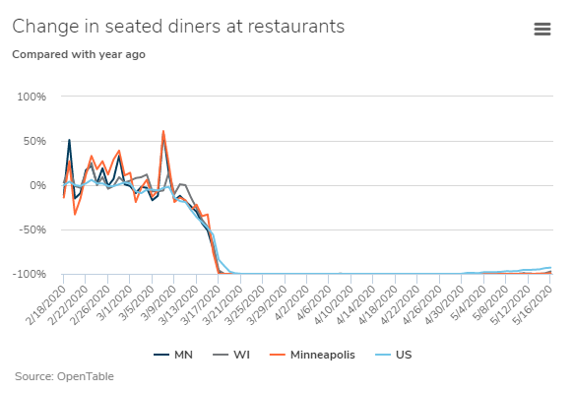
Looking ahead: Metrics worth watching
How do we track what went on last week, or even yesterday?
Minneapolis Fed COVID-19 Dashboard
minneapolisfed.org

Slide 19
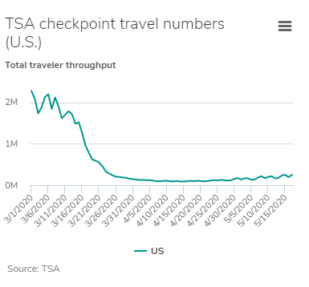
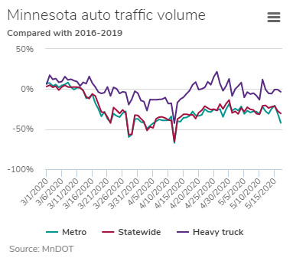
Real-time metrics

Slide 20
It’s Your turn
to teach me
and everyone else here

Slide 21
Login for interactive survey
Step 1: Send text to 22333
Step 2: Text the word minneapolis
Step 3: Hit ‘send’; watch for message
Step 4: Stay in text mode for survey

Slide 22
Notes:
Poll Title: What is the biggest obstacle to faster economic activity, or some 'return to normal'? https://www.polleverywhere.com/multiple_choice_polls/TnkbSYPC5qSUp6vVqXPqo

Slide 23
Notes:
Poll Title: What's your outlook for the next six months as it relates to your firm's solvency (simply staying in business)? https://www.polleverywhere.com/multiple_choice_polls/rwjsMSRQXfLbd5jBWQier

Slide 24
Notes:
Poll Title: How has your current outlook changed over the last 4-6 weeks? https://www.polleverywhere.com/multiple_choice_polls/rpIRGCbKZbWESgug2IpQ1

Slide 25
take-aways; looking ahead
COVID-19 has had a huge impact everywhere
Some places/businesses hurt more than others
Quick recovery appears unlikely, short of a vaccine breakthrough and ramp-up
Gradual recovery more likely, driven by consumer confidence, which will be driven (+/-) by health and economic trends, and are being closely watched by the Minneapolis Fed

Slide 26
Thank you!
Speech referrals welcome!
Twitter: @RonWirtz
@MinneapolisFed
Connect via LinkedIn
Ron.wirtz@mpls.frb.org
Thank you! And good luck!

